Slide 1
Module 5 & 6: Introduction to ML - Supervised and Unsupervised Learning
Nikhil D Jonathan, July 2026

Slide 2
Agenda :
ML framework – Supervised/Unsupervised, train/test split, overfitting
Linear Regression
Logistic Regression
Decision Trees: The most interpretable ML Model – Build and Read One
K-Means Clustering Algorithm
Model Evaluation Evaluation

Slide 3
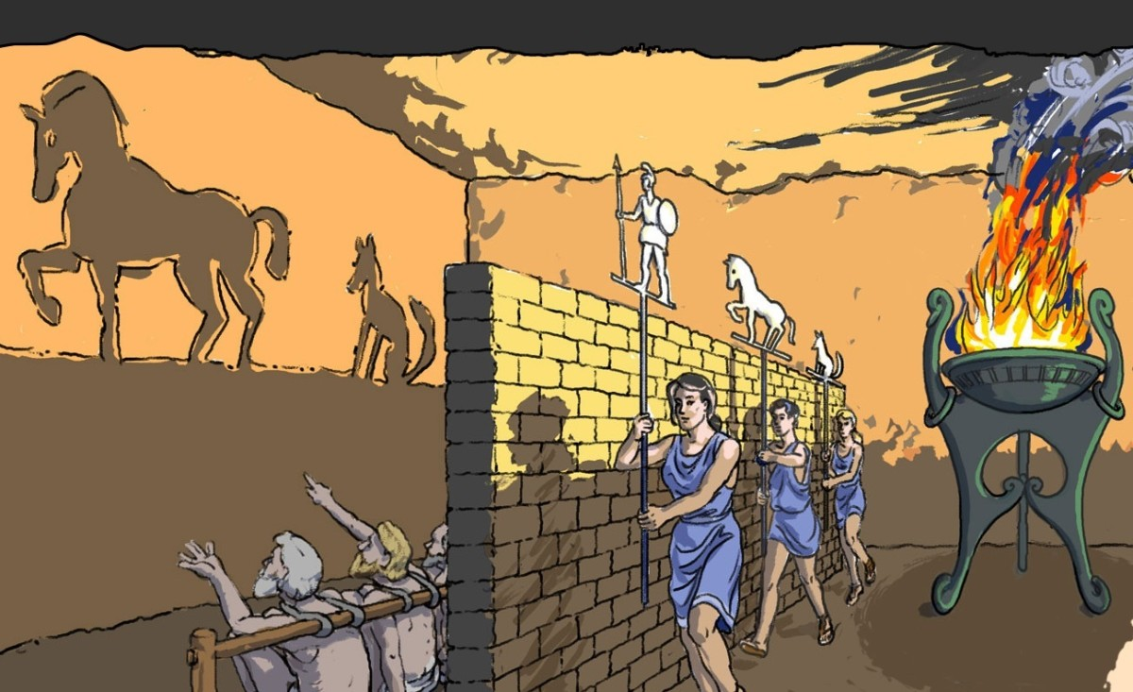
Plato’s Allegory of the Cave

Slide 4
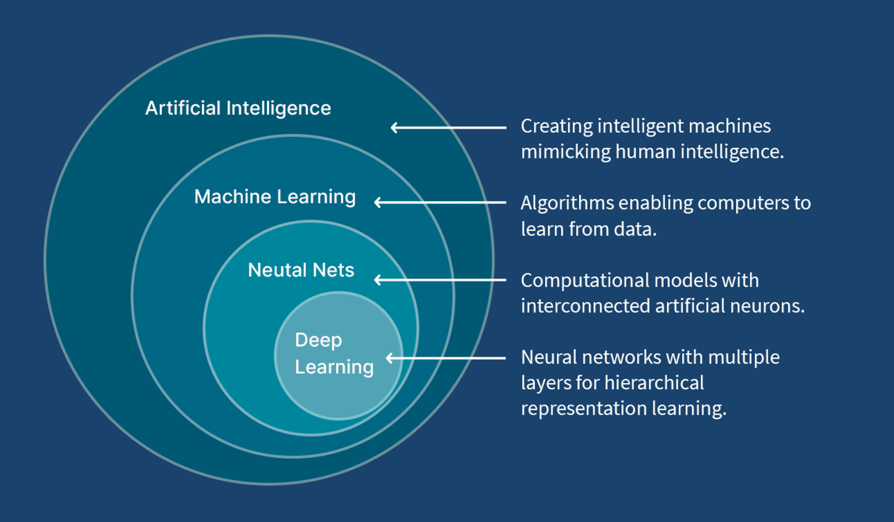
Positioning of the Machine Learning in AI Ecosystem

Slide 5
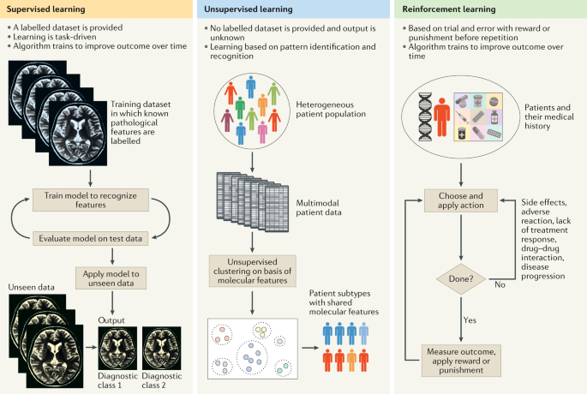
Categories/Types of Machine Learning Algorithms

Slide 6
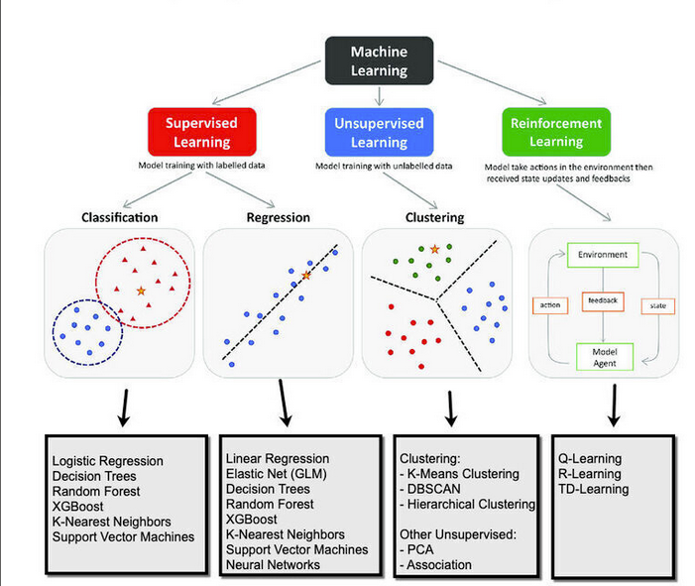

Slide 7
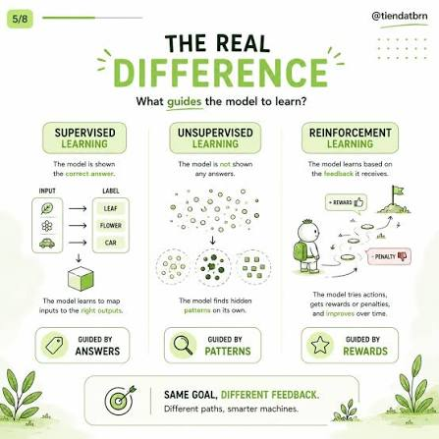

Slide 8
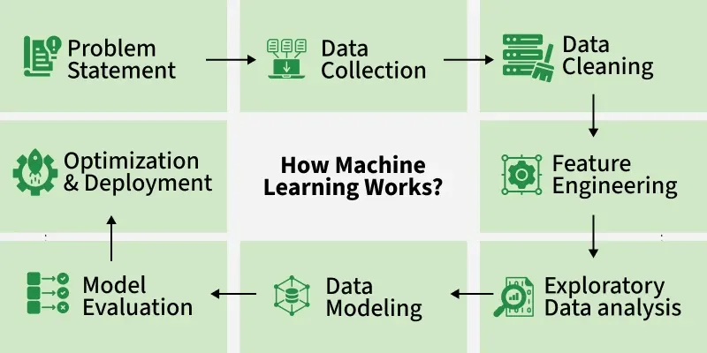

Slide 9
SUPERVISED MACHINE LEARNING

Slide 10
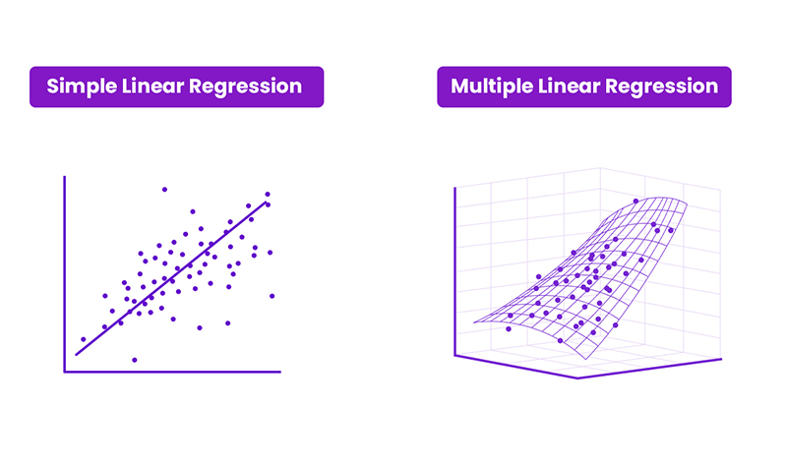
Linear Regression Model

Slide 11
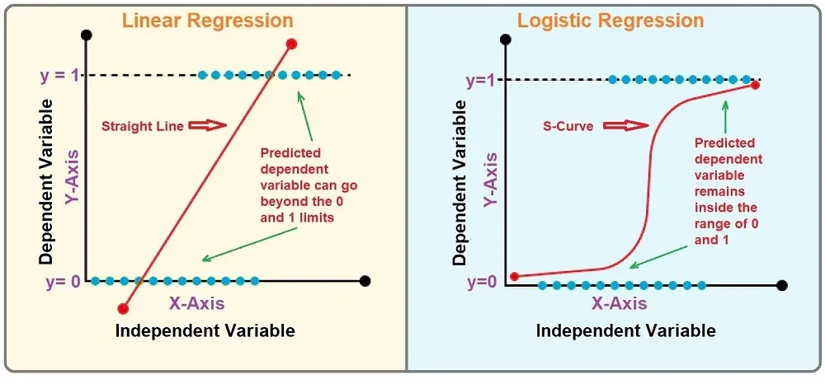
Difference between a linear and logistic regression model

Slide 12
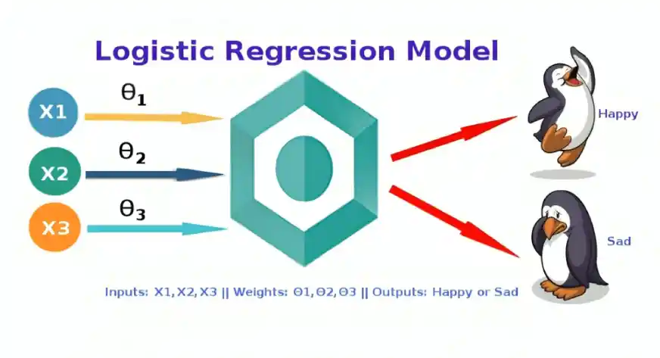
The Basic Idea of the Classification models

Slide 13
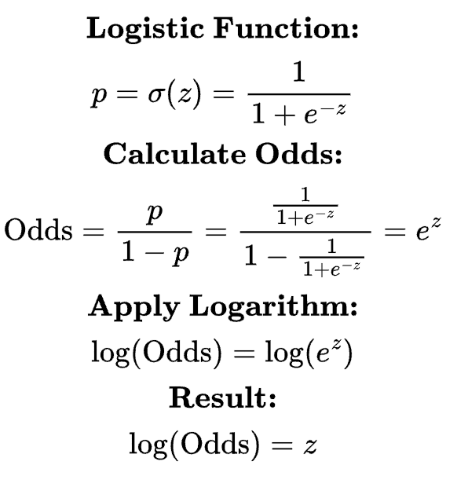
Mathematical foundation for the logistic Regression Model
Here, the Z is the regression equation
i.e. Z = y = Mx + C

Slide 14
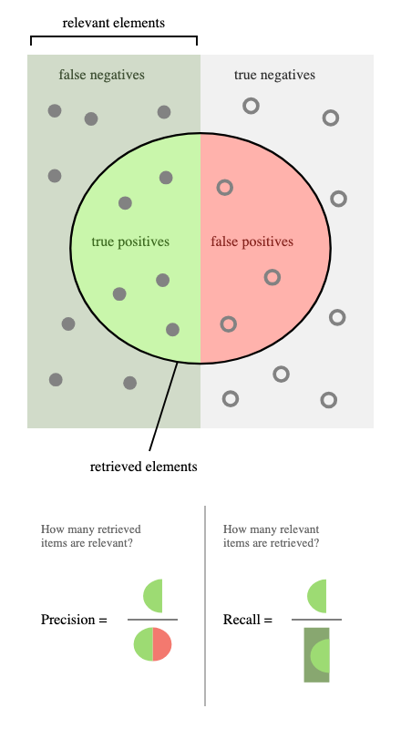
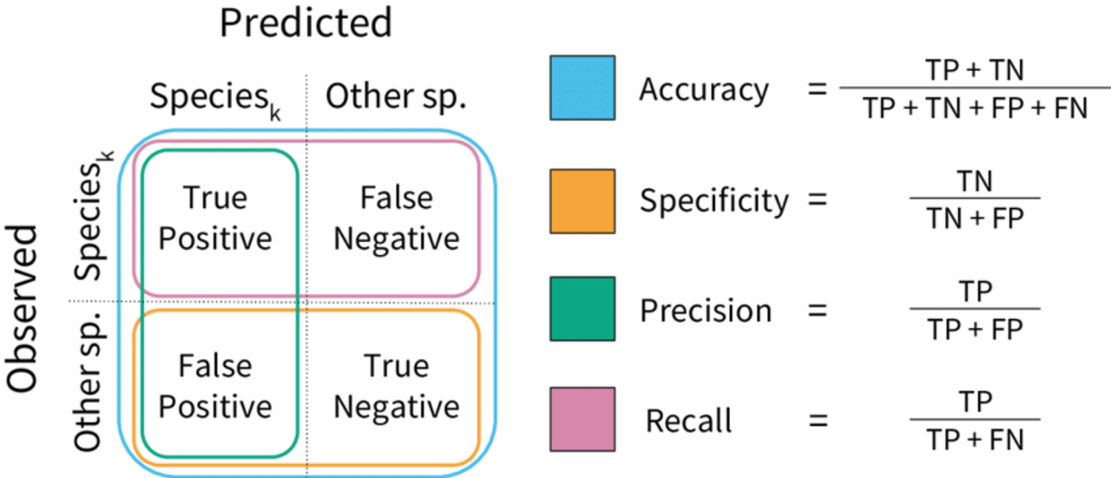
F1 Score for Imbalanced Datasets only

Slide 15
Decision Tree - Used for Classification and Regression
It is a tree-like structure where each internal node tests on attribute, each branch corresponds to attribute value and each leaf node represents the final decision or prediction.
Entropy measures the uncertainty.
Information Gain (Higher) and Gini Index (Lower) are used for attribute selection.

Slide 16
https://www.geeksforgeeks.org/machine-learning/decision-tree-introduction-example/

Slide 17
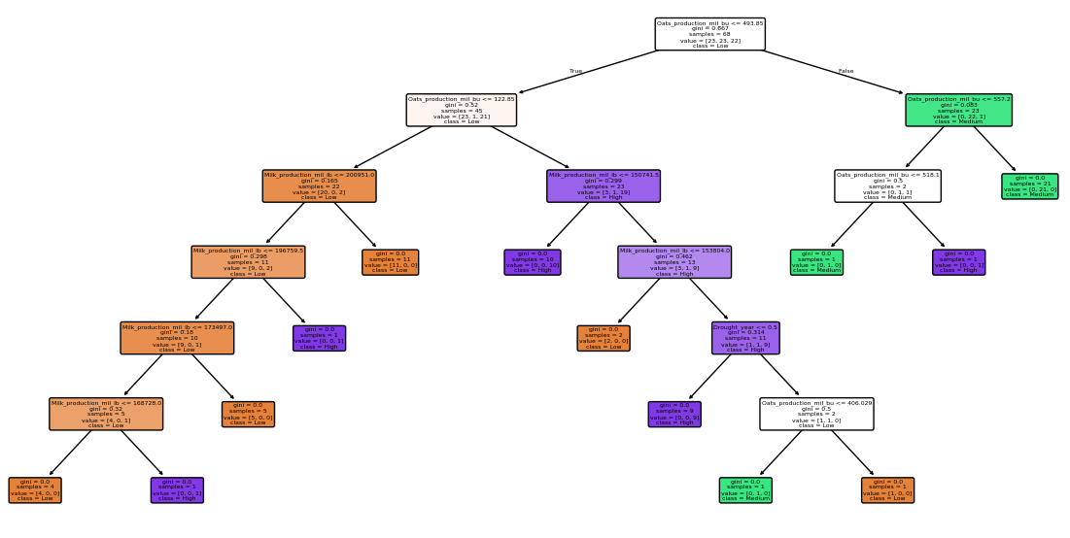
Decision Tree Classifier for Corn_Yield_Category based on the Oats supply , Milk supply and Climatic Conditions

Slide 18
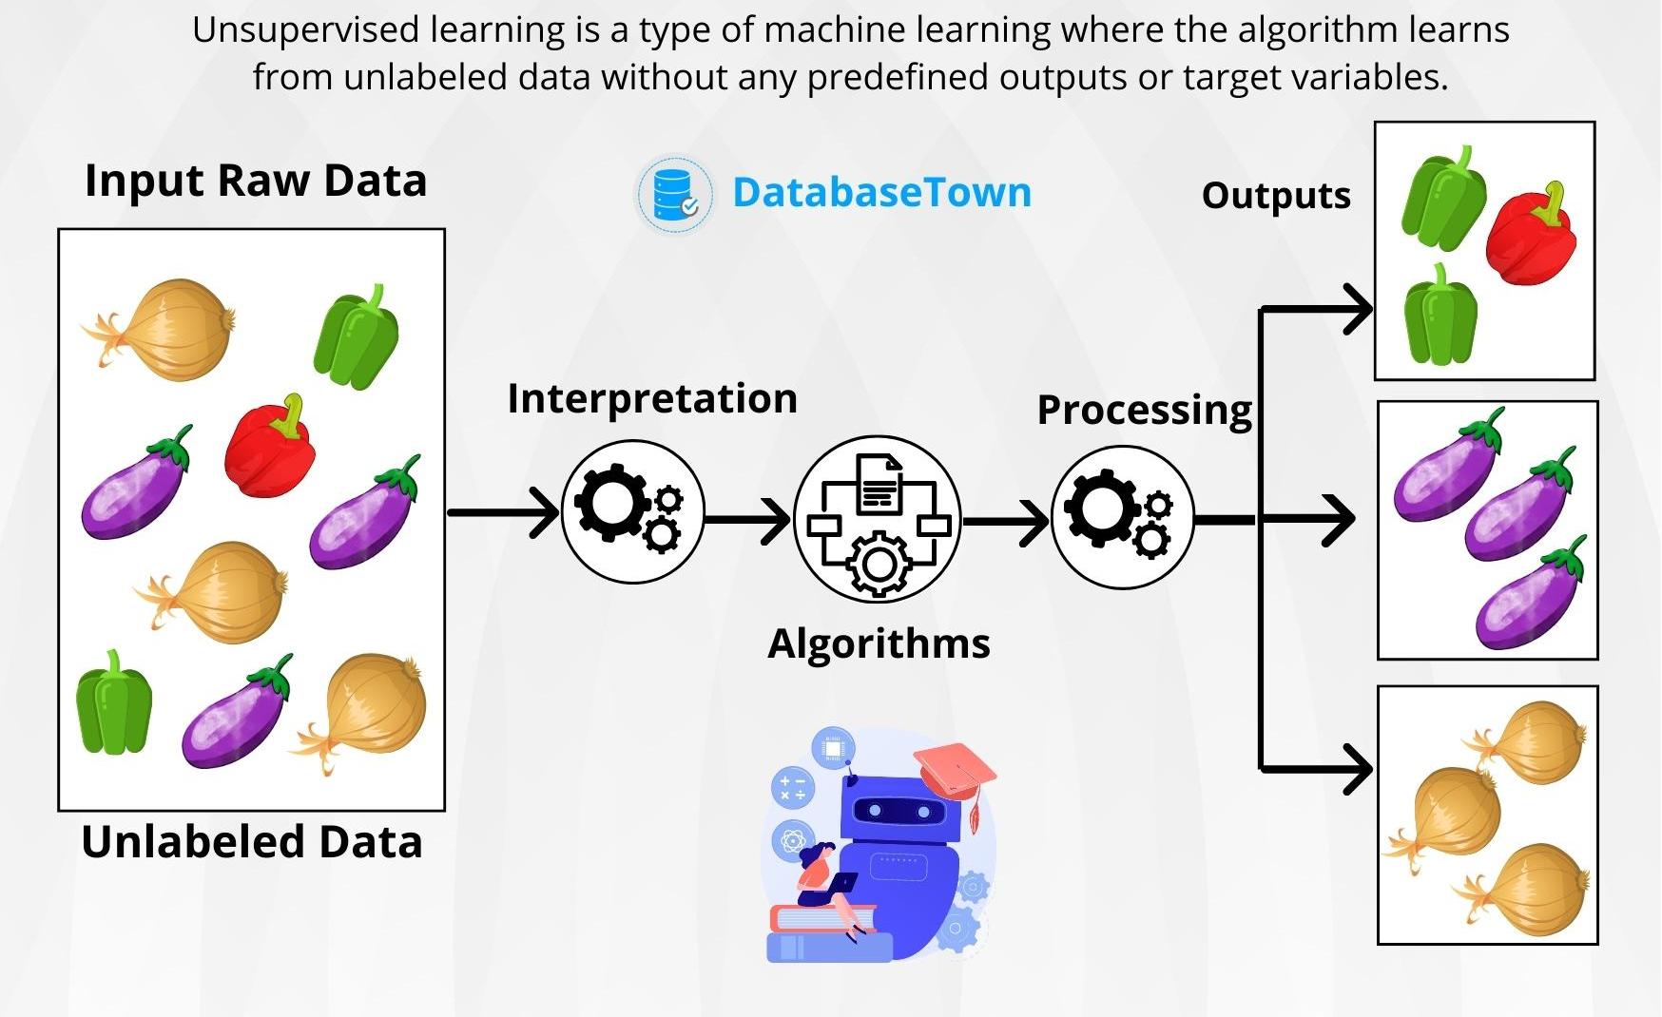
Unsupervised Learning - Clustering Algorithms

Slide 19
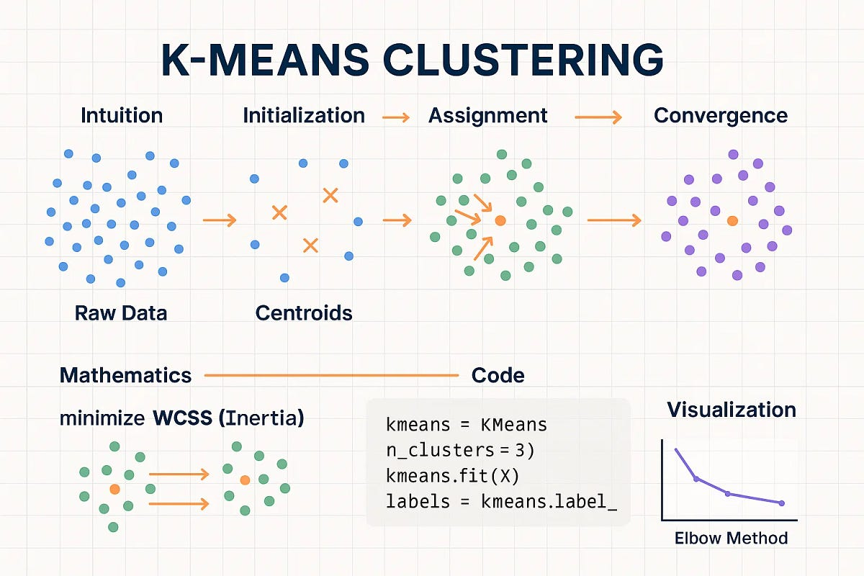

Slide 20
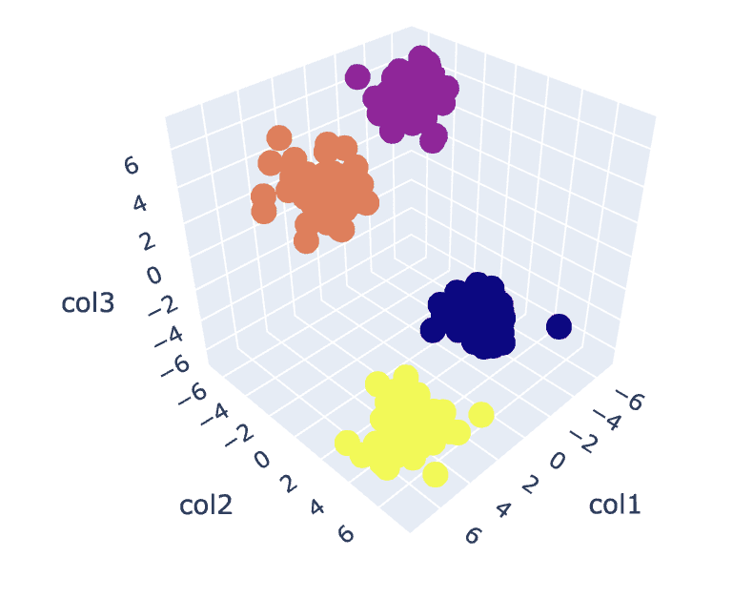
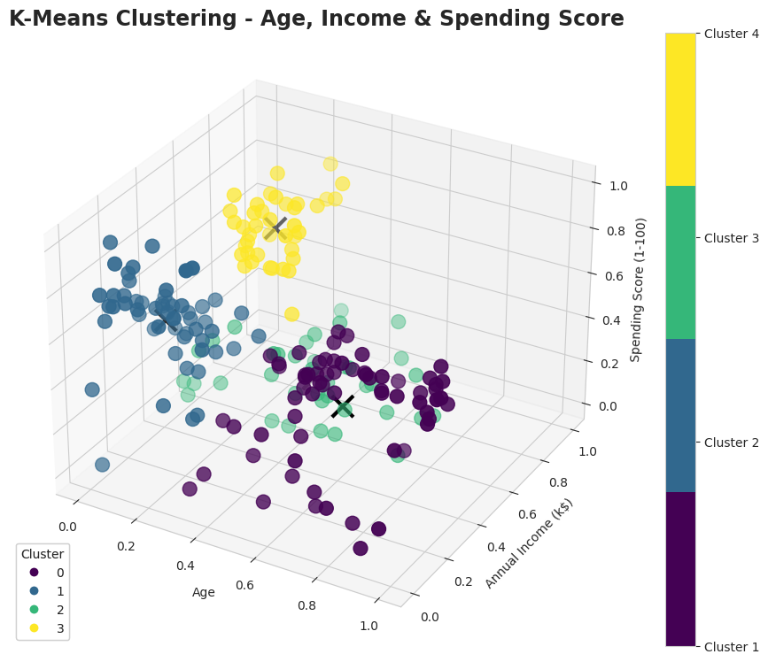
Expected Vs Actual Experiments

Slide 21
